Slide 1
Digital Portfolio
STUDENT NAME: AMUDHAMOZHI B
REGISTER NO : 2428M0062
DEPARTMENT : DATA SCIENCE
COLLEGE : SRI KRISHNA ADITYA COLLEGE OF ARTS AND SCIENCE
EMAIL ID : 24bsds105amudhamozhib@skacas.ac.in

Slide 2
PROJECT TITLE

Slide 3


AGENDA
Problem Statement
Project Overview
End Users
Tools and Technologies
Portfolio design and Layout
Features and Functionality
Results and Screenshots
Conclusion
Github Link
3/21/2024 Annual Review

Slide 4

PROBLEM STATEMENT
The purpose of this portfolio is to showcase my skills, experiences, and achievements in a professional, organized, and visually appealing manner. Many individuals struggle to effectively present their work and capabilities to potential employers, clients, or collaborators. A well-structured digital portfolio addresses this challenge by:
. Highlighting key projects and accomplishments.
. Demonstrating technical and creative skills through practical examples.
. Providing a centralized, accessible platform for professional growth and personal branding.
This portfolio aims to solve the problem of communicating expertise and career readiness in a competitive market, ensuring that my profile stands out and leaves a strong impression on the audience.

Slide 5

PROJECT OVERVIEW

Slide 6

WHO ARE THE END USERS?

Slide 7

TOOLS AND TECHNIQUES

Slide 8
POTFOLIO DESIGN AND LAYOUT
8

Slide 9
FEATURES AND FUNCTIONALITY

Slide 10
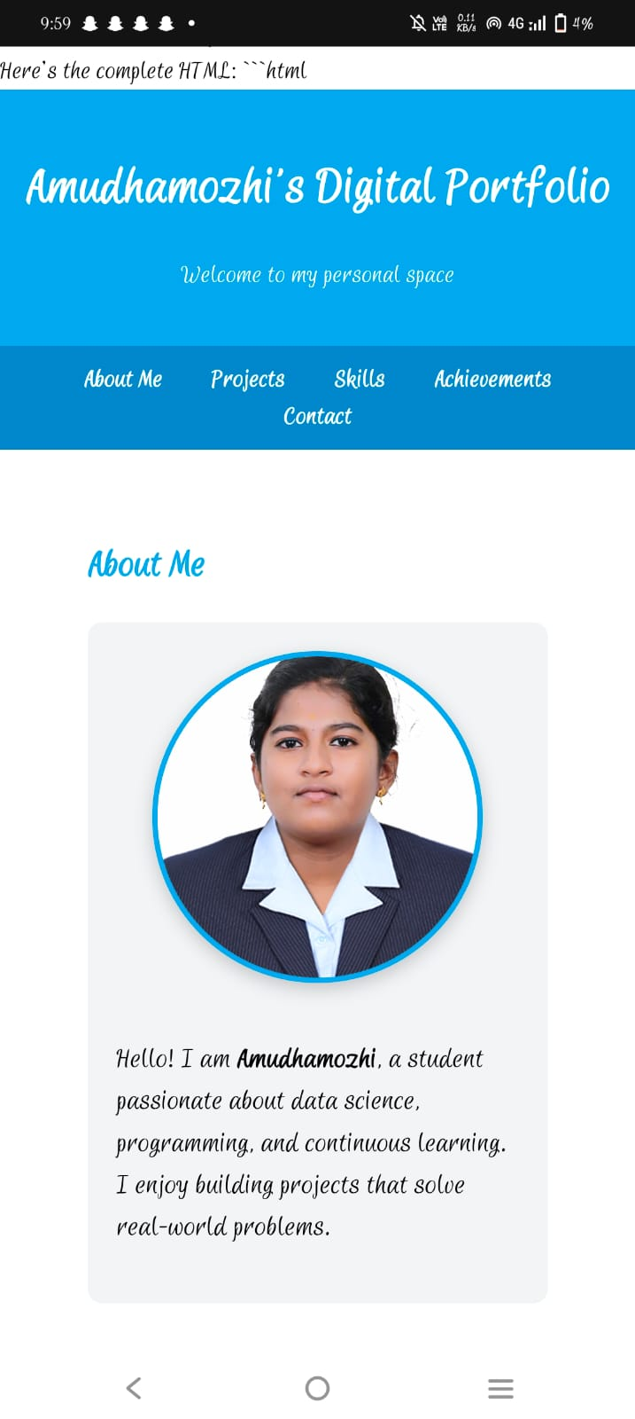
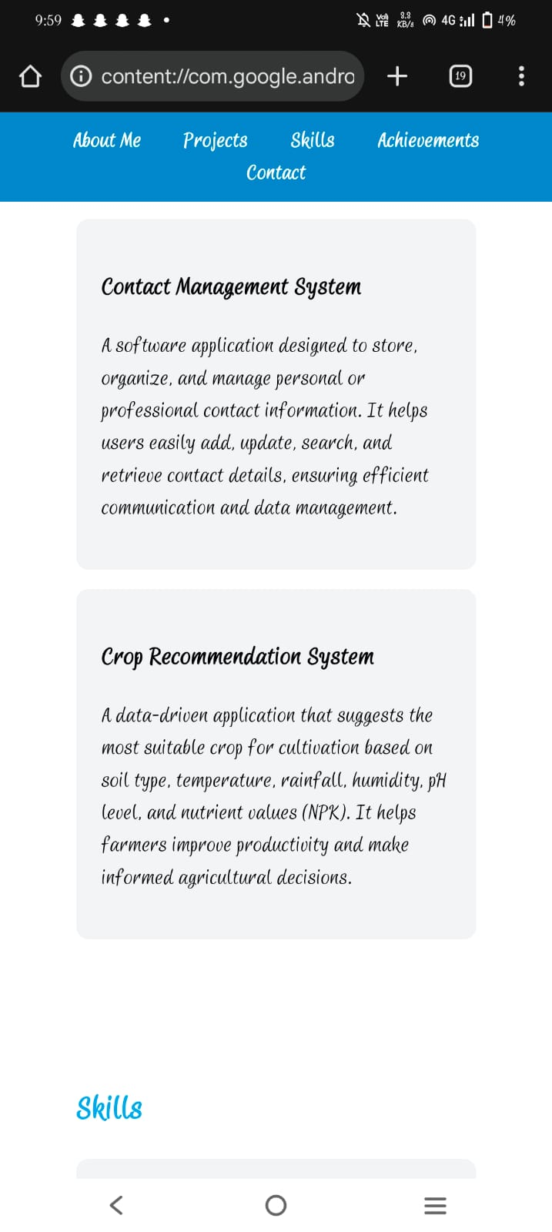

RESULTS AND SCREENSHOTS
3/21/2024 Annual Review
10

Slide 11
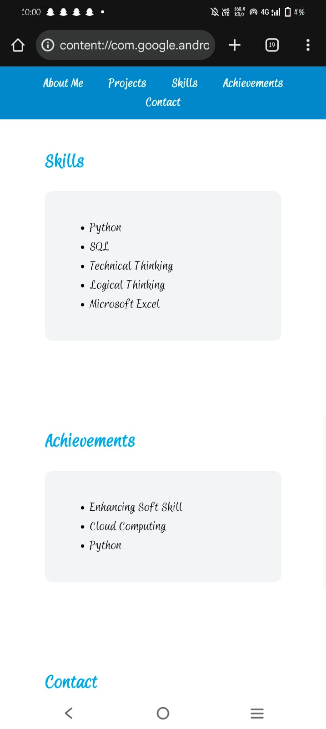
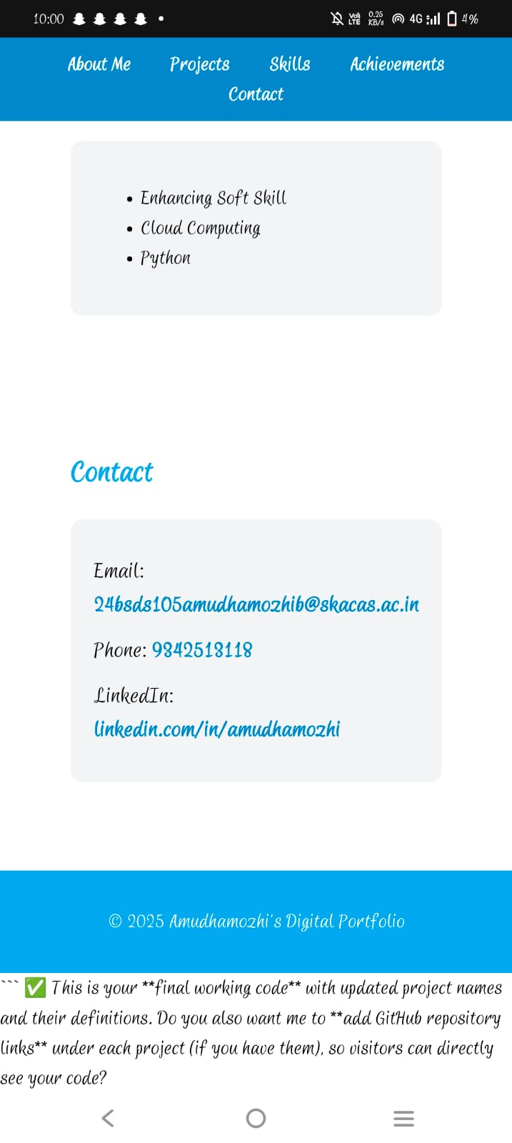
RESULTS AND SCREENSHOTS

Slide 12
CONCLUSION
12

